Slide 1
OSeMOSYS Structure – Blocks of functionality
Three levels of abstraction: Plain English description, Mathematical formulation and Code formulation
Ref: OSeMOSYS Manual - https://osemosys.readthedocs.io/en/latest/
Objective
  To estimate the lowest Net Present Value (NPV) of an energy system to meet given demand(s) for energy
Costs
  Account for the costs incurred by each technology in each year and in each region
  Capacity adequacy
  There must be enough capacity for each technology in order to meet its energy use or production requirements:
    Capacity adequacy A: Each time slice / Capacity adequacy B: Each year
Storage
  It adds independent energy balances and constraints for storage options.

Slide 2
OSeMOSYS Structure – Blocks of functionality
Energy balance
  Operation levels are calculated for each time slice and each year. The production, use and demand must be feasible at each timeslice and annually
    Energy balance A: Each time slice / Energy balance B: Each year
Constraints
  Maximum/minimum limit on capacity of a technology allowed for a year or total period and a region
  Maximum/minimum limit on new capacities of a technology for a year and a region
  Maximum/minimum limit on activity of a technology for a year or total period and a region
  There must be enough capacity to provide a reserve margin (for specified technologies)
Emissions
  The extent to which pollutants are emitted is determined by multiplying “emissions per unit of activity” and the annual activity of a technology

Slide 3
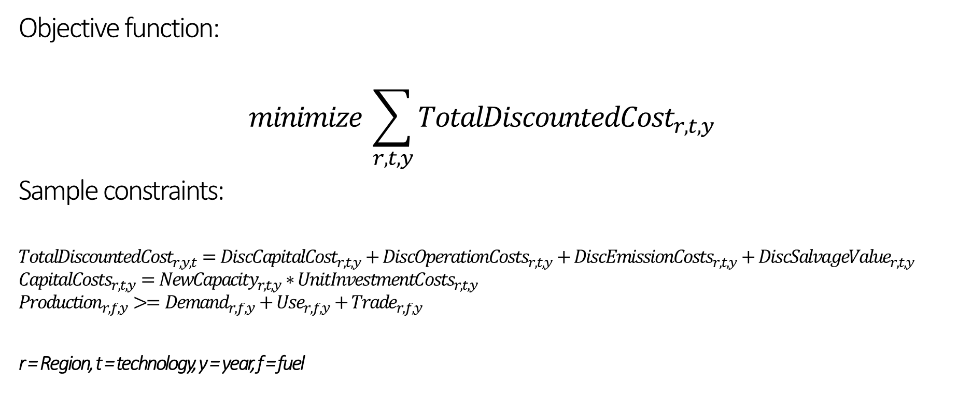
Mathematical Formulation of OSeMOSYS
Objective function:
$$minimize \sum_{r,t,y}{{TotalDiscountedCost}_{r,t,y} }$$
Sample constraints:
$${TotalDiscountedCost}_{r,y,t}={DiscCapitalCost}_{r,t,y}+{DiscOperationCosts}_{r,t,y}+{DiscEmissionCosts}_{r,t,y}+{DiscSalvageValue}_{r,t,y}$$
$${CapitalCosts}_{r,t,y}={NewCapacity}_{r,t,y}∗{UnitInvestmentCosts}_{r,t,y}$$
$${Production}_{r,f,y}>={Demand}_{r,f,y}+{Use}_{r,f,y}+{Trade}_{r,f,y}$$
r = Region, t = technology, y = year, f = fuel

Slide 4
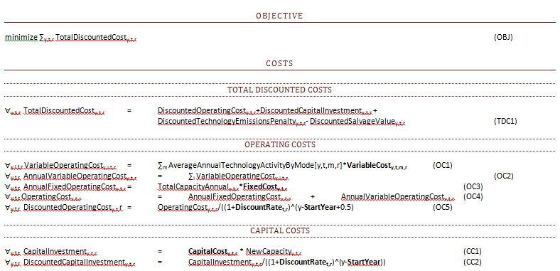
Example of Mathematical Formulation of OSeMOSYS

Slide 5
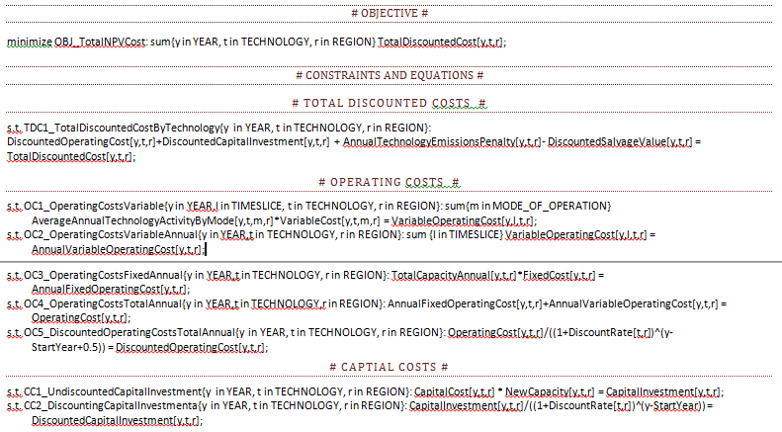
Example of Code of OSeMOSYS

Slide 6
OSeMOSYS – Key terms
Five key terms in OSeMOSYS:
  Sets: Input, constant for all scenarios
  Parameters: Input, can differ between scenarios
  Variables: Modelling outputs
  Constraints: can be equalities or inequalities the limit the solution space and should be satisfied all the time.
  Objective Function: of the linear programing problem (to minimize cost)
Two versions of the code:
  Long code: easy to read but requires larger matrix size and computational time.
  Short code: combines some of the intermediate equations to reduce the matrix size and computational time.

